Slide 1
Why visualize?

Slide 2
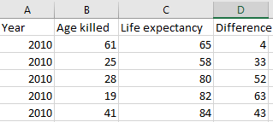
Raw data on gun murders from…
FBI’s Uniform Crime Report
World Health Organization’s UNSD Demographic Statistics
Compiled by periscopic.com

Slide 3


Slide 4
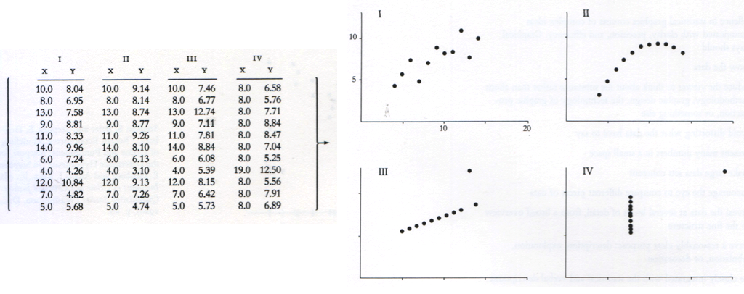
Anscombe’s Quartet
N = 11
Mean of X = 9
Mean of Y = 7.5
Variance of X = 11
Variance of Y = 4.1
Cor(X,Y) = 0.816

Slide 5
Anscombe’s Quartet

Slide 6
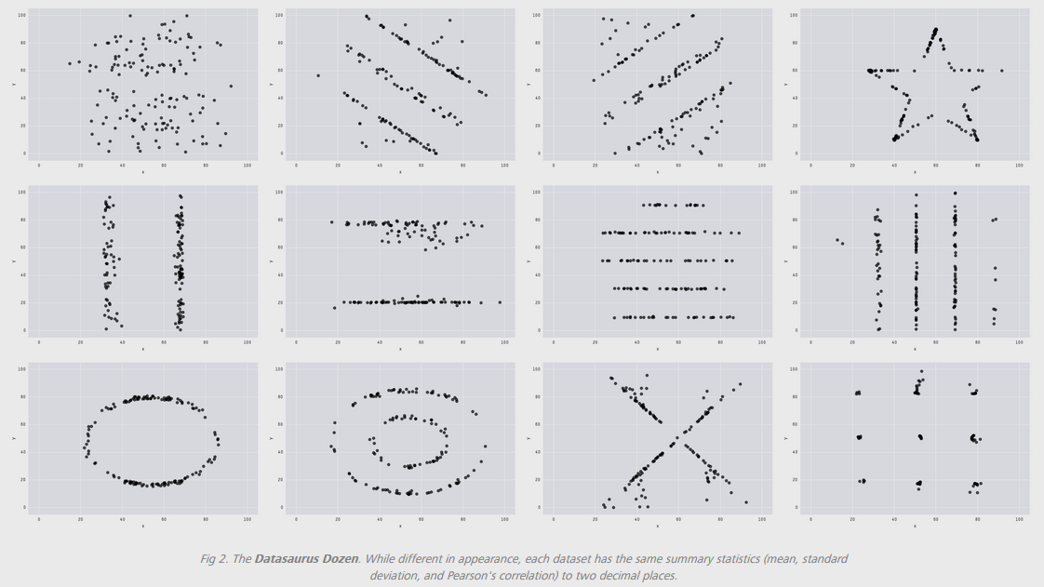
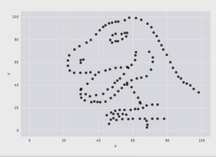
Datasaurus dozen
E(X) = 54.26; E(Y) = 47.83; SD(X) = 16.76; SD(Y) = 26.93; Cor(X,Y) = -0.06
Justin Matejka & George Fitzmaurice: https://www.autodeskresearch.com/publications/samestats

Slide 7
For each of the following graphs,
What are the primary messages of the visualization?
Extract at least 3 pieces of information.
What information is easy to extract?
What information is difficult to extract?
What could be done to improve the readability of the visualization?

Slide 8
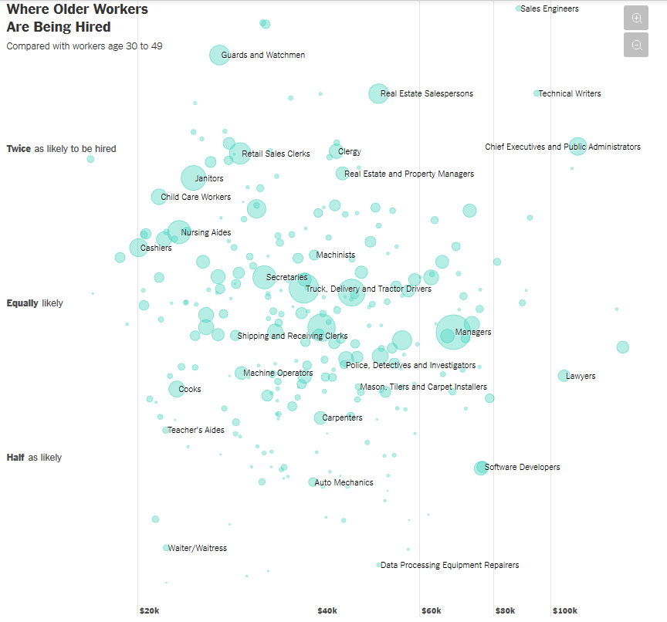
Graph 1
http://nyti.ms/2pC2HZv

Slide 9
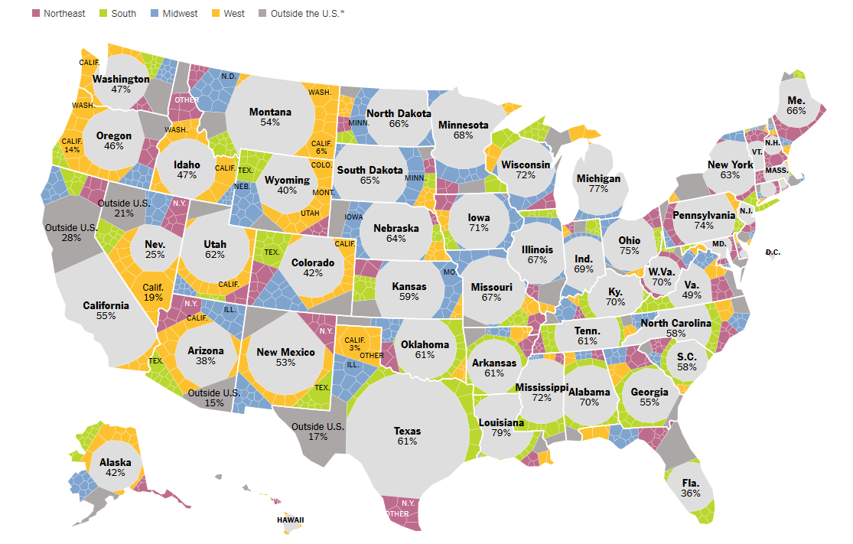
Graph 2
http://nyti.ms/2qwlIS6

Slide 10
Principles of effective data visualization

Slide 11
1. Understand how we perceive differences

Slide 12


http://bit.ly/2q6aNgY

Slide 13
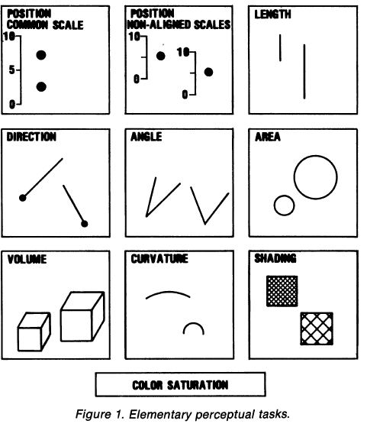
Elementary Perceptual Tasks (EPTs)
Cleveland & McGill, p532

Slide 14
Which represents the larger value? Which EPT did you use?
From Stat 405 notes by Hadley Wickham

Slide 15
Which represents the larger value? Which EPT did you use?
From Stat 405 notes by Hadley Wickham

Slide 16
Hue
Saturation
Value
HSV: 3 dimensions of color

Slide 17
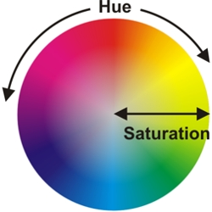

Slide 18
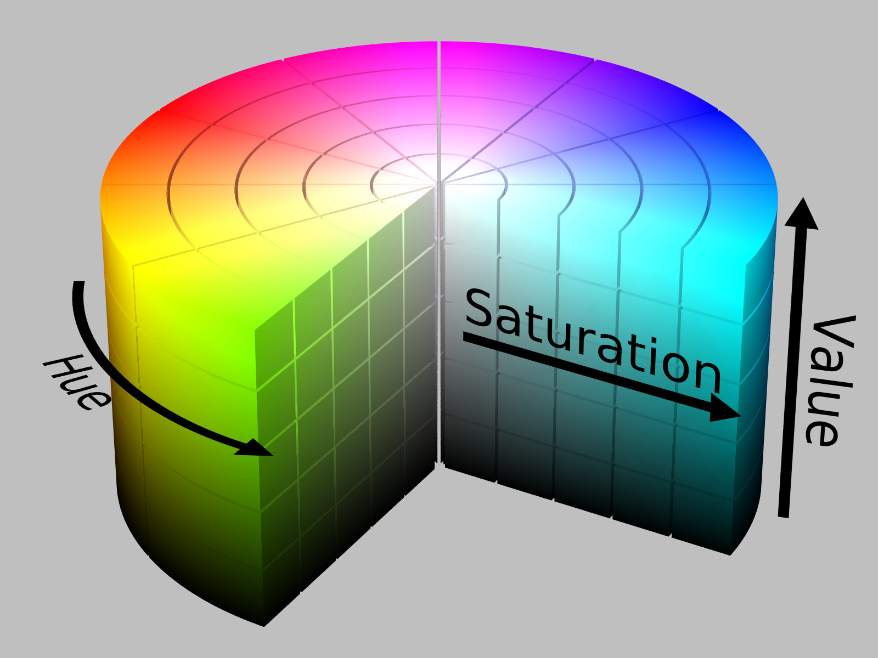
https://chroma.readthedocs.io/en/latest/

Slide 19
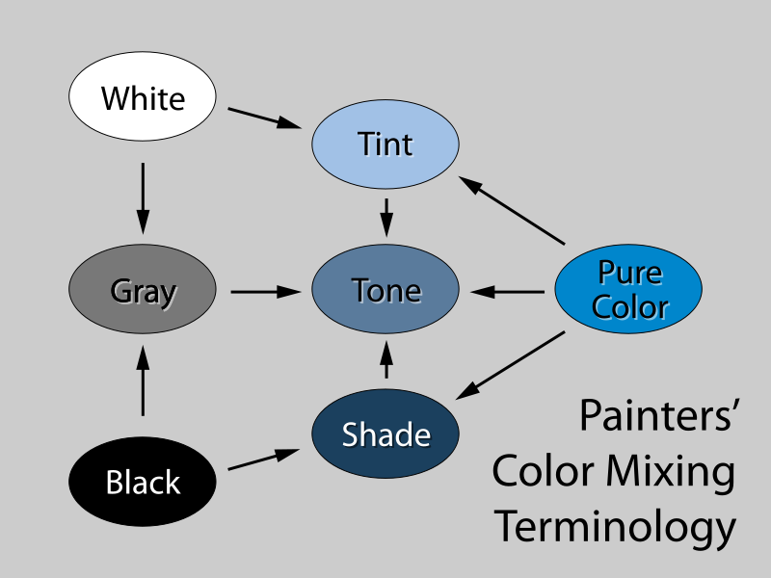
Saturation (aka “color ramp”)
Value
(aka “gray ramp”)
http://www.beginnersschool.com/2015/10/27/basic-color-theory/

Slide 20


Saturation = 1, Value = 1
Hue = 2/3
Hue = 0

Slide 21


Hue = 0, Value = 1
Saturation = 0.2
Saturation = 0.5
Saturation = 1

Slide 22


Hue = 0, Saturation = 1
Value = 0.5
Value = 0.8
Value = 1

Slide 23


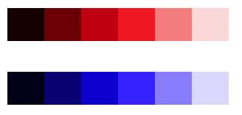
Issues with HSV
6 hues, same value, different perceived lightness:
Converting to grayscale:
Equidistant changes in value not created equal; red step appears much more drastic than blue step:
https://www.vis4.net/blog/posts/avoid-equidistant-hsv-colors/

Slide 24

Hue Chroma Luminance
6 hues on HSV scale; same saturation and value:
Same hues using HCL scale; same chroma and luminance:
https://www.vis4.net/blog/posts/avoid-equidistant-hsv-colors/

Slide 25
2. Match EPTs to data type (quantitative, ordinal, nominal)

Slide 26
Which represents the larger value? Which EPT did you use?

Slide 27
Which represents the larger value? Which EPT did you use?

Slide 28
EPT | Ordered? | Appropriate for:
Position | Yes | Quantitative, ordinal, nominal
Size (length, angle, volume) | Yes | Quantitative, ordinal, nominal
Saturation (color ramp) | Yes | Quantitative, ordinal, nominal
Value (gray ramp) | Yes | Quantitative, ordinal, nominal
Hue | No | Nominal only
Shape | No | Nominal only

Slide 29
3. Exploit our most efficient EPTs

Slide 30
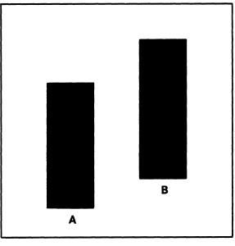
Which bar is tallest?
Which EPT are you using?
From Cleveland and McGill, p 538

Slide 31
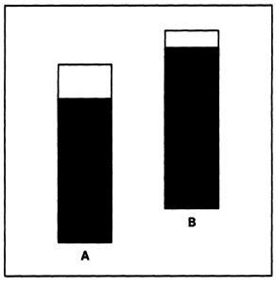
Which bar is tallest?
Which EPT are you using?
From Cleveland and McGill, p 538

Slide 32
Better yet…

Slide 33
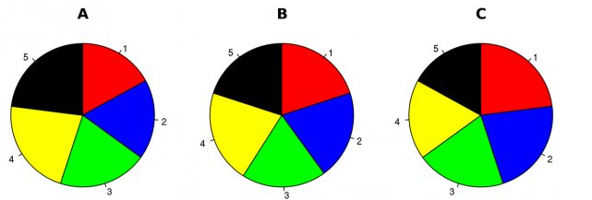
Hypothetical polling data on 5 candidates at initial time point A.
Which EPTs do you use to answer the following:
Is Candidate 5 doing better than Candidate 3?
Who’s doing the best? The worst?
Walter Hickey at Business Insider

Slide 34
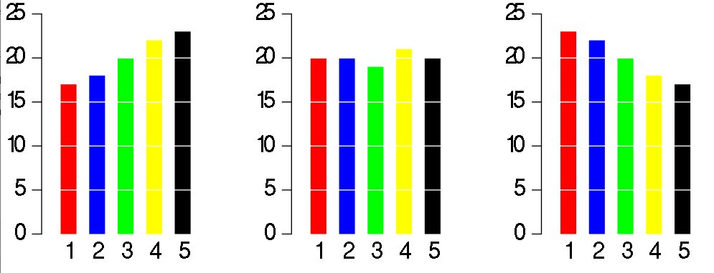
Same data, different graph
Which EPTs do you use to answer the following:
Is Candidate 5 doing better than Candidate 3?
Who’s doing the best? The worst?
Walter Hickey at Business Insider

Slide 35
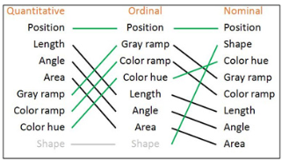

Value
Saturation
Hue
From Ben Jones, Visualizing Data with Tableau, p9

Slide 36
Back to Cleveland and McGill…what is the size of Quantity A relative to Quantity B?
a
b
Figures revised by Hadley Wickham

Slide 37
What about now?
a
b
Figures revised by Hadley Wickham

Slide 38
What about now?
a
b
Figures revised by Hadley Wickham

Slide 39
What about now?
b
a
Figures revised by Hadley Wickham

Slide 40
What about now?
b
a
Figures revised by Hadley Wickham

Slide 41
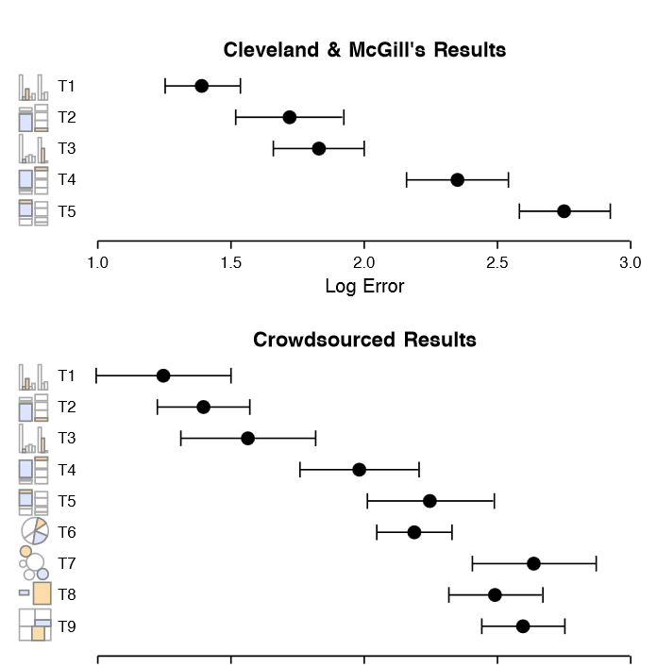
J. Heer and
M. Bostock. Crowdsourcing graphical perception: Using mechanical turk to assess visualization design. In CHI 2010, 2010.

Slide 42
4. Make important comparisons easy

Slide 43
Back to the 5 hypothetical candidates at 3 time points:
Walter Hickey at Business Insider

Slide 44
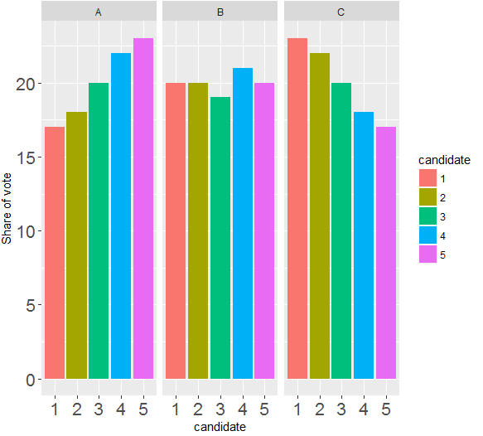
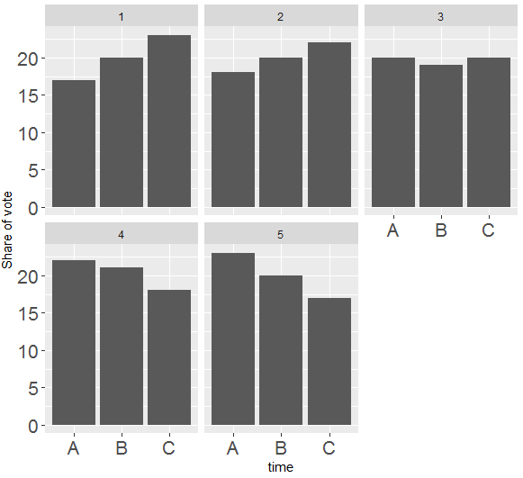
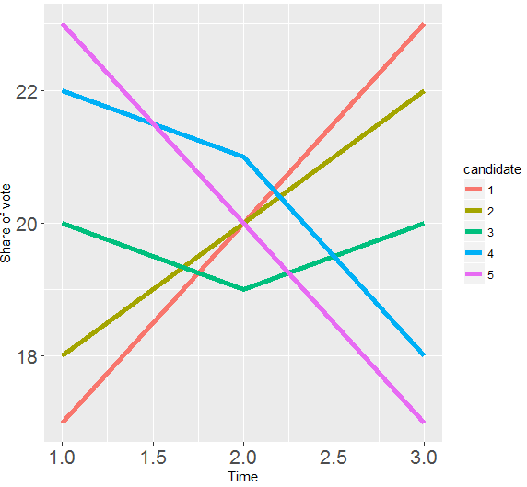
Alternative takes:
In groups;
What are the variables?
For each graph, which EPTs are used to map the variables?
Which graph(s) have redundant EPTs?
Which graph(s) should be used to answer which candidate is doing the worst at Time B? Why?
Which graph(s) should be used to answer candidates are losing steam? Why?
Which graph(s) should be used to answer which candidate has the most momentum in the race? Why?

Slide 45
Given what you know now, revisit the two NYT vizzes.
In groups;
What are the variables?
For each graph, which EPTs are used to map the variables?
Are the EPT choices appropriate?
Are the EPT choices effective?
Are important comparisons made easy?

Slide 46
Graph 1
http://nyti.ms/2pC2HZv

Slide 47
Graph 2
http://nyti.ms/2qwlIS6

